Slide 1
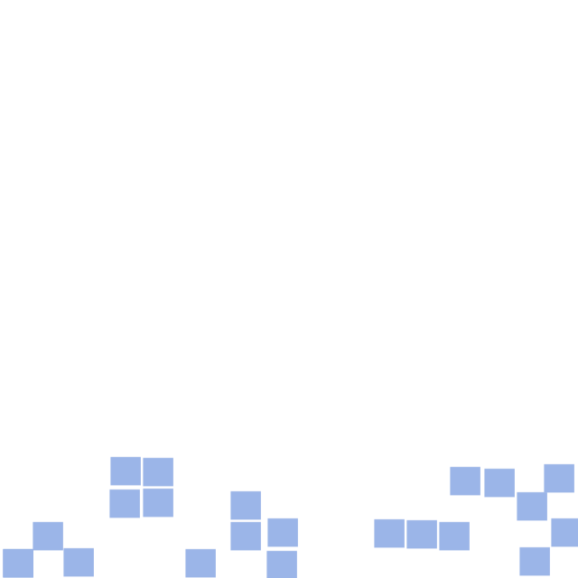
Conway's Game of Life
http://pavolondzik.github.io/GoL/
Pavol Ondzik
Denzel Dadson

Slide 2
Cellular Automata
Period
Speed
Rules

Slide 3
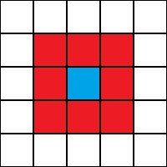
Conway's Game of Life
John Horton Conway, Scientific American (April 1970)
Cellular Automaton
Zero-player game
Field of cells, each has eight
neighbours ->
Moore neighbourhood.
A cell is either occupied (by an organism) or not.
Notes:
The three main components of a Cellular
Automata are:
➟The array dimension (Vast Parallelism: Cellular computing can
involve 10^5 or more cells)
➟The neighborhood structure (Locality)
➟The transition rule
(Simplicity): the basic processing element, the cell, is simple
is the smallest structural and functional unit of all living organisms, which has all the basic qualities of life. Jan Evangelista Purkyně,
Cellular Computing = simplicity + vast parallelism + locality

Slide 4









Rules for Conway’s Game of Life
Rules for deriving a generation from
the previous one :
Birth
Survival
Death
Notes:
A dead cell with exactly three live neighbours becomes a live cell (birth).
A live cell with two or three live neighbours stays alive (survival).
In all other cases, a cell dies or remains dead (overcrowding or loneliness).

Slide 5

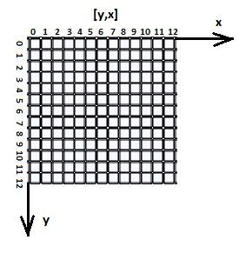
Patterns
Block (still life)
Blinker (period 2 oscillator)
Glider (spaceship)
Pulsar (period 3 oscillator)
Cartesian coordinate
system

Slide 6
Algorithm

Slide 7
Thank you for your attention!

Slide 8
References
http://www.math.com/students/wonders/life/life.html
http://en.wikipedia.org/wiki/Conway%27s_Game_of_Life
http://www.julianpulgarin.com/canvaslife/

